Slide 1
Introduction to Biostatistics
Inferential Statistics and Hypothesis Testing
Session 3 - Inferential Statistics and Hypothesis Testing Concepts
16/05/23

Slide 2
Introduction
What does Inferential Statistics talk about?
Inferential Statistics is a large part of statistics that is focused on how to generalize the results - achieved by analysis of samples – to the population.
Studies are usually carried out using samples, as access to all population under study is either impossible or expensive.
We are then required to generalize such results to the entire population, as the ultimate goal of any study is to make a decision that is applied to the entire population.
The methods focused on such generalization of the results is called statistical inference.

Slide 3
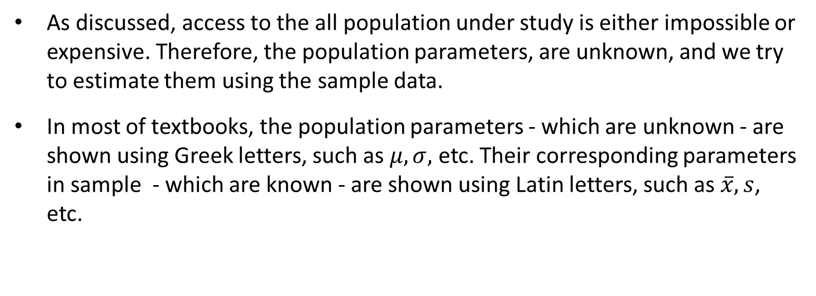
Population Parameters
As discussed, access to the all population under study is either impossible or expensive. Therefore, the population parameters, are unknown, and we try to estimate them using the sample data.
In most of textbooks, the population parameters - which are unknown - are shown using Greek letters, such as $μ,σ,$ etc. Their corresponding parameters in sample - which are known - are shown using Latin letters, such as $\overline{x}, s$, etc.

Slide 4
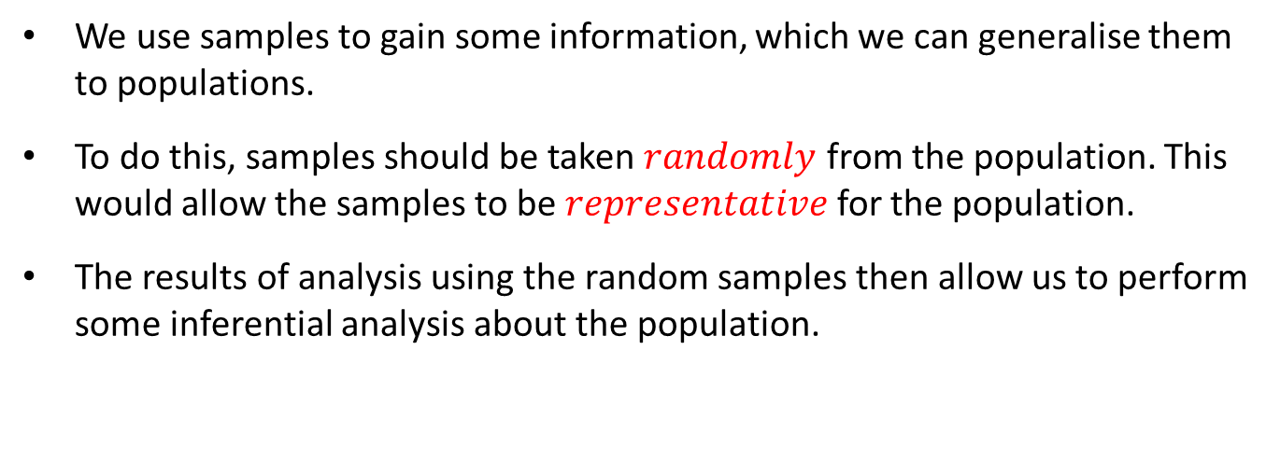
Sampling Concepts
We use samples to gain some information, which we can generalise them to populations.
To do this, samples should be taken $randomly$ from the population. This would allow the samples to be $representative$ for the population.
The results of analysis using the random samples then allow us to perform some inferential analysis about the population.

Slide 5
Elements of Inferential Statistics
Confidence Interval
To determine interval that contains the actual population parameter
Hypothesis Testing
Type I and Type II Errors– when to use which test
p-value
To determine significance

Slide 6
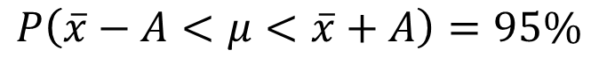
Understanding Confidence Interval
$$P\left(T−A<θ<T+A\right)=1−α$$
$$P\left(\overline{x}−A<μ<\overline{x}+A\right)=95\%$$

Slide 7
Hypothesis Testing
We initially introduce the concept of “Hypothesis Testing”, using a story!
The aim of this story is to first “logically” understand the “concepts” and “elements” of “Hypothesis Testing”.
We would later show that “Hypothesis Testing” and “Confidence Interval” are two sides of the same coin called “Statistical Inference”.
Later, we’ll introduce a couple of expressions for CIs, as well as learning the instructions of conducting “Hypothesis Testing” for a couple of “Population Parameters”.

Slide 8


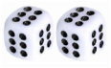

… and now the Story of “Hypothesis Testing” !
Please listen to this story carefully. It is an important one!
The Story of
Hypothesis Testing
By: Bahman Honari

Slide 9
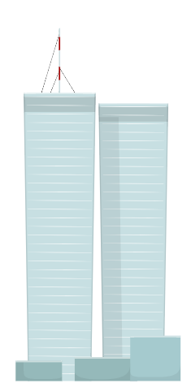


The Story of Hypothesis Testing
This is Mary, a friend of mine!

Slide 10

The Story of Hypothesis Testing – Cont.
Mary needs 400,000 bulbs!

Slide 11

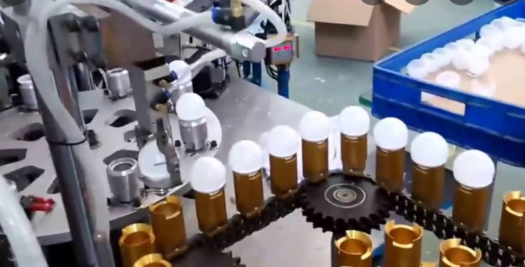
The Story of Hypothesis Testing – Cont.
This is John, another friend of mine!

Slide 12

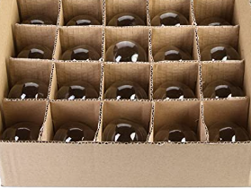
The Story of Hypothesis Testing – Cont.
20 bulbs in each box!

Slide 13

The Story of Hypothesis Testing – Cont.
Now, I am thinking about quality of those bulbs!

Slide 14


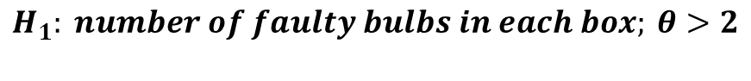
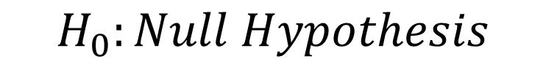
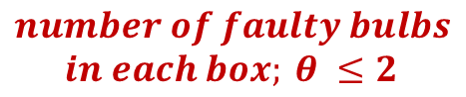
The Story of Hypothesis Testing – Cont.
Let me ask John!
$$number of faulty bulbs$$
$$in each box; θ ≤2$$
$$H_{0}:Null Hypothesis$$
$$H_{1}: number of faulty bulbs in each box; θ>2$$

Slide 15


The Story of Hypothesis Testing – Cont.
Can you imagine Mary at the Dubai Port?

Slide 16

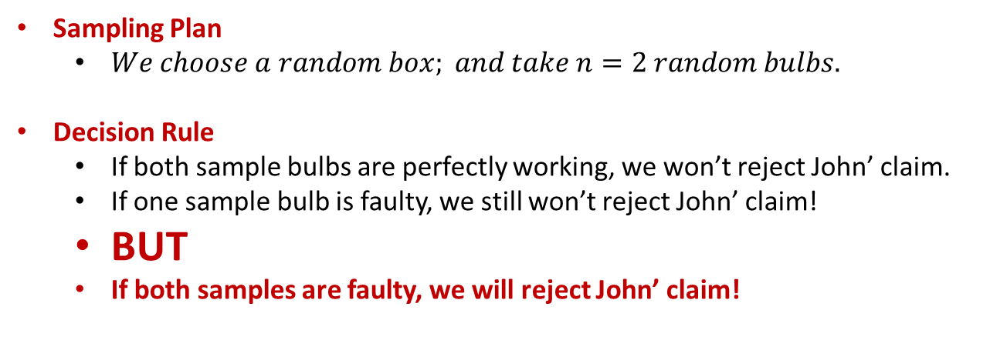
The Story of Hypothesis Testing – Cont.
OK, Let’s agree on something with John.
Sampling Plan
$We choose a random box; and take n=2 random bulbs.$
Decision Rule
If both sample bulbs are perfectly working, we won’t reject John’ claim.
If one sample bulb is faulty, we still won’t reject John’ claim!
BUT
If both samples are faulty, we will reject John’ claim!

Slide 17

The Story of Hypothesis Testing – Cont.
Probability of getting 2 faulty bulb out of 2 random samples of the box of 20
If 2 faulty bulbs in the box: If 5 faulty bulbs in the box:
0.00526315 0.05263158
If 7 faulty bulbs in the box: If 10 faulty bulbs in the box:
0.1105263 0.2368421

Slide 18
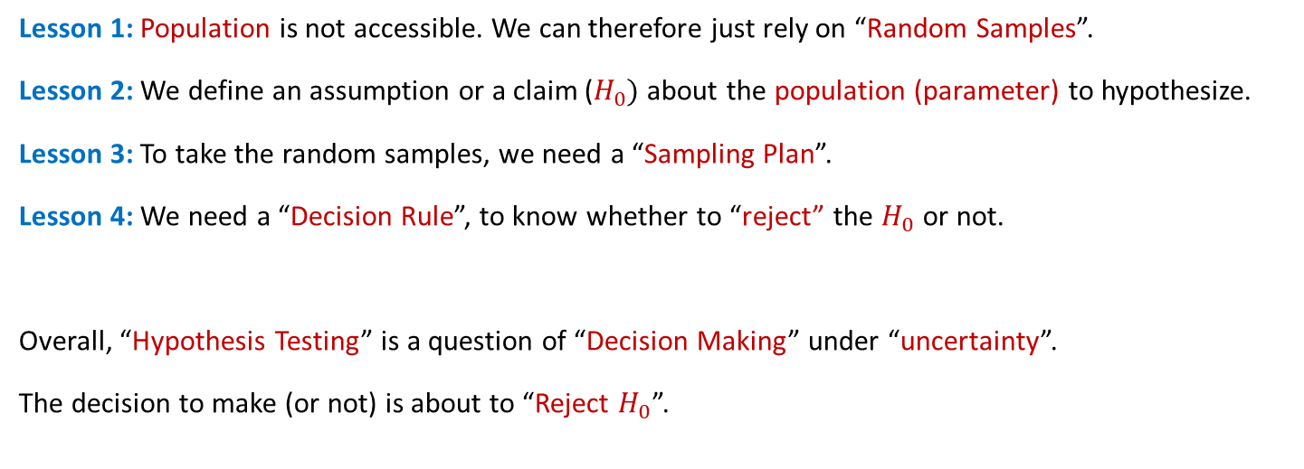
The Story of Hypothesis Testing – Cont.
The Lessons, so far!
Lesson 1: Population is not accessible. We can therefore just rely on “Random Samples”.
Lesson 2: We define an assumption or a claim ($H_{0})$about the population (parameter) to hypothesize.
Lesson 3: To take the random samples, we need a “Sampling Plan”.
Lesson 4: We need a “Decision Rule”, to know whether to “reject” the $H_{0}$ or not.
Overall, “Hypothesis Testing” is a question of “Decision Making” under “uncertainty”.
The decision to make (or not) is about to “Reject $H_{0}$”.

Slide 19
The Story of Hypothesis Testing – Cont.
Now, a little bit Logic!
When you are about to make a decision - under uncertainty - You won’t make a decision that seems to be “very risky”! Right? Be logical please!
Now let’s go back to our story of “Hypothesis Testing”. John makes a claim; if the random samples that you took from the box, tell us that it is “very unlikely” that his claim is correct, you will “Reject” his claim, simply because the “risk” that you are “making a wrong decision” by rejecting his claim is “very low”. Poem:
When Risk Is Low
The Null Must Go!
Now, let’s review a couple of scenarios.

Slide 20

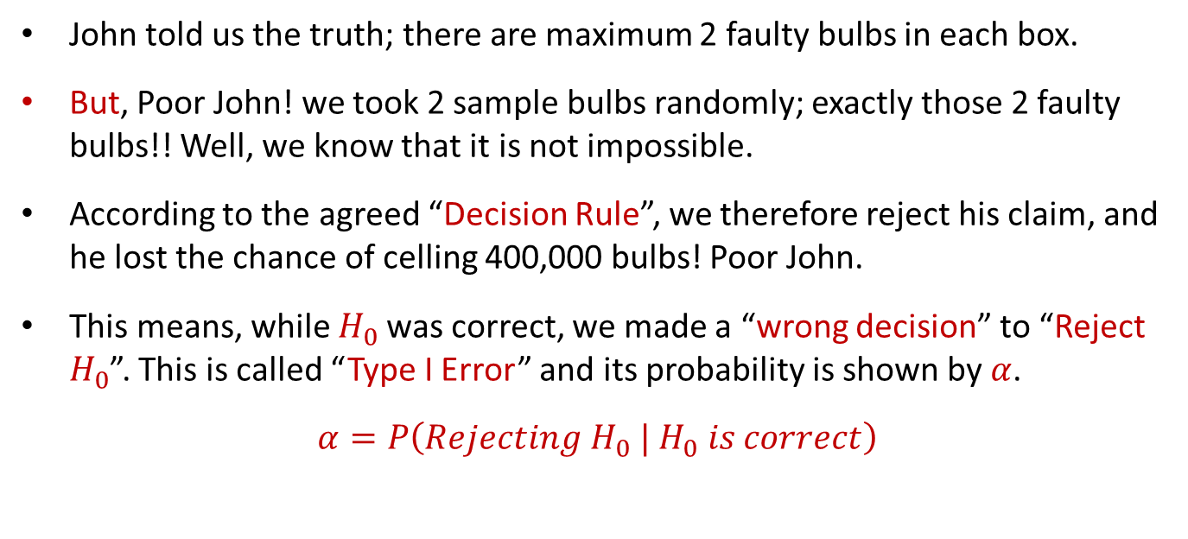
The Story of Hypothesis Testing – Cont.
Scenario 1: Poor John!
John told us the truth; there are maximum 2 faulty bulbs in each box.
But, Poor John! we took 2 sample bulbs randomly; exactly those 2 faulty bulbs!! Well, we know that it is not impossible.
According to the agreed “Decision Rule”, we therefore reject his claim, and he lost the chance of celling 400,000 bulbs! Poor John.
This means, while $H_{0}$was correct, we made a “wrong decision” to “Reject $H_{0}$”. This is called “Type I Error” and its probability is shown by $α$.
$α=P\left(Rejecting{ H}_{0} |{ H}_{0} is correct\right)$
Read this vertical line “while”.

Slide 21
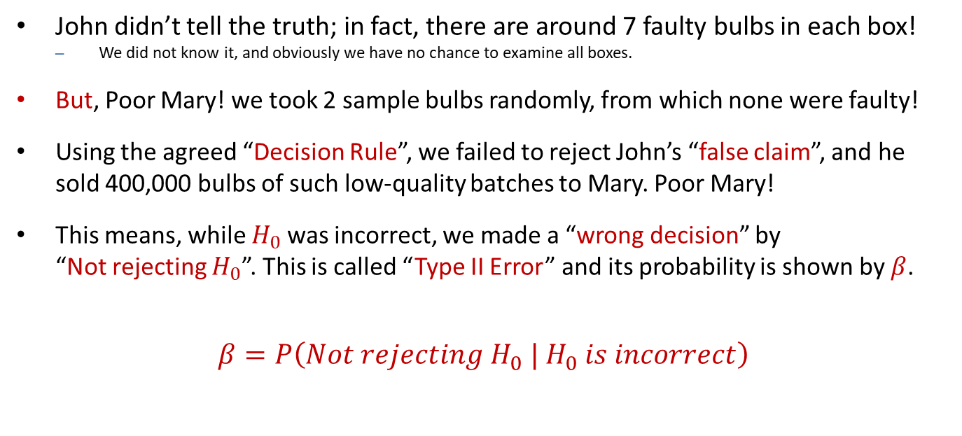
The Story of Hypothesis Testing – Cont.
Scenario 2: Poor Mary!
John didn’t tell the truth; in fact, there are around 7 faulty bulbs in each box!
We did not know it, and obviously we have no chance to examine all boxes.
But, Poor Mary! we took 2 sample bulbs randomly, from which none were faulty!
Using the agreed “Decision Rule”, we failed to reject John’s “false claim”, and he sold 400,000 bulbs of such low-quality batches to Mary. Poor Mary!
This means, while $H_{0}$was incorrect, we made a “wrong decision” by “Not rejecting $H_{0}$”. This is called “Type II Error” and its probability is shown by $β$.
$β=P\left(Not rejecting{ H}_{0} |{ H}_{0} is incorrect\right)$

Slide 22
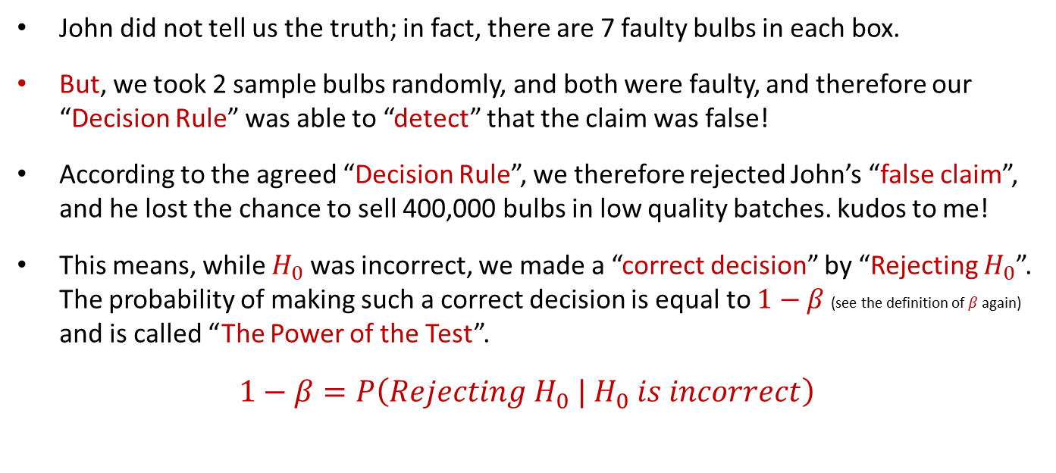
The Story of Hypothesis Testing – Cont.
Scenario 3: Kudos to Me!
John did not tell us the truth; in fact, there are 7 faulty bulbs in each box.
But, we took 2 sample bulbs randomly, and both were faulty, and therefore our “Decision Rule” was able to “detect” that the claim was false!
According to the agreed “Decision Rule”, we therefore rejected John’s “false claim”, and he lost the chance to sell 400,000 bulbs in low quality batches. kudos to me!
This means, while $H_{0}$was incorrect, we made a “correct decision” by “Rejecting $H_{0}$”. The probability of making such a correct decision is equal to $1−β$ (see the definition of $β$again) and is called “The Power of the Test”.
$1−β=P\left(Rejecting{ H}_{0} |{ H}_{0} is incorrect\right)$

Slide 23
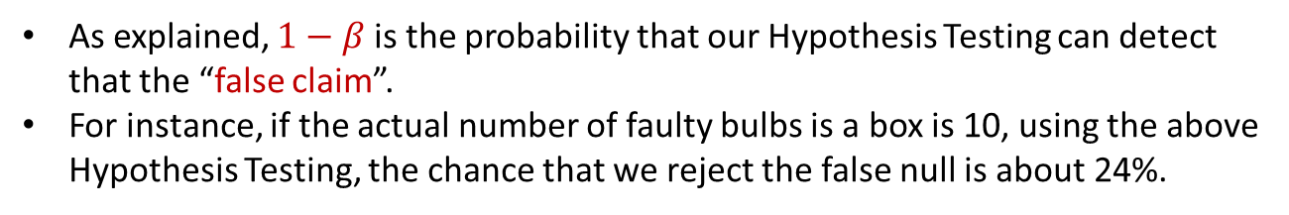
The Story of Hypothesis Testing – Cont.
A Table of the Test Power Calculation
As explained, $1−β$ is the probability that our Hypothesis Testing can detect that the “false claim”.
For instance, if the actual number of faulty bulbs is a box is 10, using the above Hypothesis Testing, the chance that we reject the false null is about 24%.

Slide 24
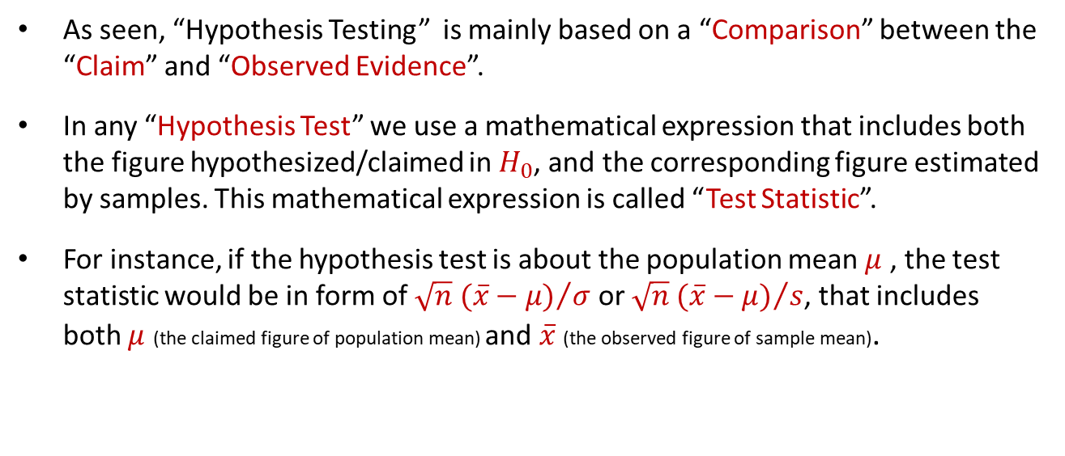
The Story of Hypothesis Testing – Cont.
Test Statistic
As seen, “Hypothesis Testing” is mainly based on a “Comparison” between the “Claim” and “Observed Evidence”.
In any “Hypothesis Test” we use a mathematical expression that includes both the figure hypothesized/claimed in $H_{0}$, and the corresponding figure estimated by samples. This mathematical expression is called “Test Statistic”.
For instance, if the hypothesis test is about the population mean $μ$ , the test statistic would be in form of ${\sqrt{n} (\overline{x}−μ)}/σ$ or ${\sqrt{n} (\overline{x}−μ)}/s$, that includes both $μ$ (the claimed figure of population mean) and $\overline{x}$ (the observed figure of sample mean).

Slide 25
The Story of Hypothesis Testing – Cont.
Test Statistic – Cont.
As the “Test Statistic” includes the results from the observed “Random samples”, it’s figure is something “Random”.
The “Test Statistic”, in essence, is defined to present the difference between the “Claim” and “Observation”. If this difference is “Big Enough” - logically - we will “Reject” the “Claim”. Otherwise, we do not reject it. Is this logical?
Of course it is! But, what does “Big Enough” actually mean?

Slide 26
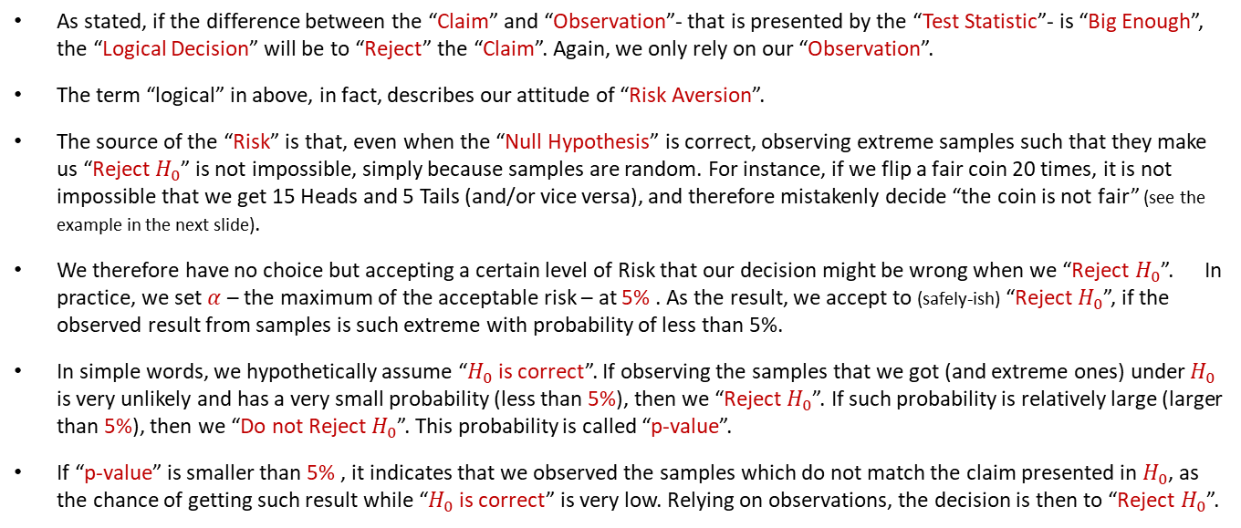
The Story of Hypothesis Testing – Cont.
p-value.
As stated, if the difference between the “Claim” and “Observation”- that is presented by the “Test Statistic”- is “Big Enough”, the “Logical Decision” will be to “Reject” the “Claim”. Again, we only rely on our “Observation”.
The term “logical” in above, in fact, describes our attitude of “Risk Aversion”.
The source of the “Risk” is that, even when the “Null Hypothesis” is correct, observing extreme samples such that they make us “Reject $H_{0}$” is not impossible, simply because samples are random. For instance, if we flip a fair coin 20 times, it is not impossible that we get 15 Heads and 5 Tails (and/or vice versa), and therefore mistakenly decide “the coin is not fair” (see the example in the next slide).
We therefore have no choice but accepting a certain level of Risk that our decision might be wrong when we “Reject $H_{0}$”. In practice, we set $α$ – the maximum of the acceptable risk – at 5% . As the result, we accept to (safely-ish) “Reject $H_{0}$”, if the observed result from samples is such extreme with probability of less than 5%.
In simple words, we hypothetically assume “$H_{0}$ is correct”. If observing the samples that we got (and extreme ones) under $H_{0}$ is very unlikely and has a very small probability (less than 5%), then we “Reject $H_{0}$”. If such probability is relatively large (larger than 5%), then we “Do not Reject $H_{0}$”. This probability is called “p-value”.
If “p-value” is smaller than 5% , it indicates that we observed the samples which do not match the claim presented in $H_{0}$, as the chance of getting such result while “$H_{0}$is correct” is very low. Relying on observations, the decision is then to “Reject $H_{0}$”.

Slide 27
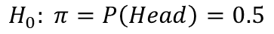
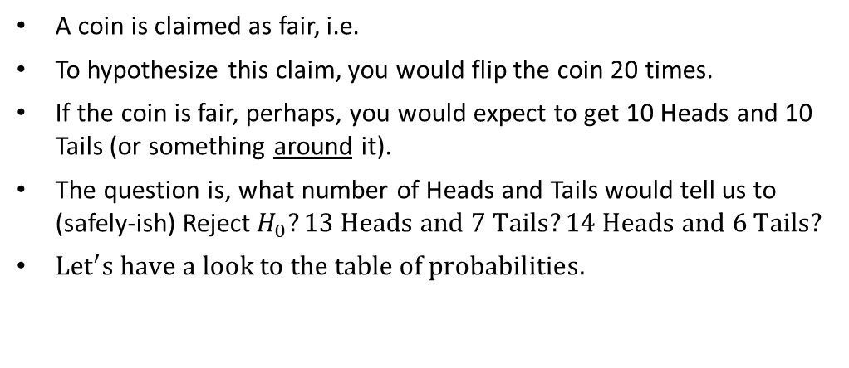
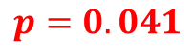
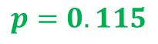
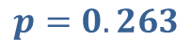
The Story of Hypothesis Testing – Cont.
Another Example
A coin is claimed as fair, i.e.
To hypothesize this claim, you would flip the coin 20 times.
If the coin is fair, perhaps, you would expect to get 10 Heads and 10 Tails (or something around it).
The question is, what number of Heads and Tails would tell us to (safely-ish) Reject$H_{0}?13 Heads and 7 Tails?14 Heads and 6 Tails?$
${Let}^{′}s have a look to the table of probabilities.$
$$H_{0}: π=P\left(Head\right)=0.5$$
$$p=0.263$$
$$p=0.115$$
$$p=0.041$$

Slide 28
The Story of Hypothesis Testing – Cont.
Final Words
We use the terms “Statistically Significant” difference/association when the p-value is less than 5%. Again, the poem is:
When p Is Low
The Null Must Go!
It is very important to understand that “Statistical Significance” does not necessarily show an “Important and/or Clinical Difference” (and vice versa).

